Slide 1
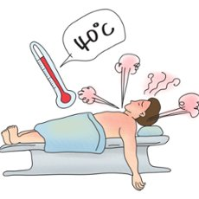
Malignant Hyperthermia

Slide 2
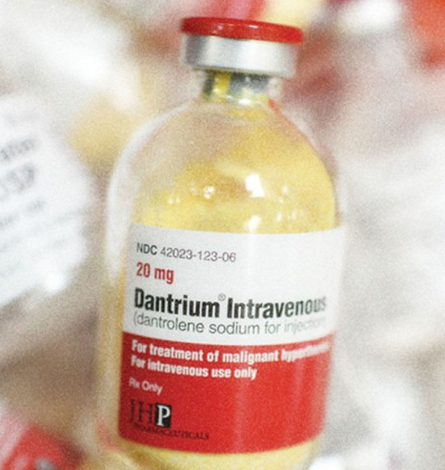
What is Malignant Hyperthermia?
Malignant Hyperthermia (MH) is a rare, inherited musculoskeletal syndrome that presents as a hypermetabolic reaction triggered by exposure to volatile anesthetic gases (e.g., desflurane, enflurane, halothane, sevoflurane) or the depolarizing muscle relaxant, succinylcholine. Joint Commission requires that settings that stock succinylcholine, even if only for the purpose of emergency airway management, should have Dantrolene available and a Malignant Hyperthermia crisis protocol in place.

Slide 3
Can Malignant Hyperthermia Occur Outside of the OR?
Yes. While most cases of MH occur during general anesthesia, the one-hour period immediately following surgery (including the recovery room) is also a critical time. In addition, MH can occur if trigger anesthetics and/or succinylcholine are used in any location, such as emergency rooms, dental surgeries, surgeon’s offices or intensive care units.

Slide 4
Who is Susceptible?
A patient with an autosomal dominant inheritance pattern, usually have a 50% chance of inheriting a gene defect for MH.
It is important to know that not everyone who has a gene defect linked to MH develops the MH crisis upon each exposure to the triggering anesthetics. (Ask for any reaction to anesthesia or family history of reaction?)
A patient getting anesthesia, succinylcholine, within 24 hours.

Slide 5
Signs and Symptoms
Common Signs & Symptoms
Tachycardia
Tachypnea
Muscle rigidity/spasms
Rapid increase in temperature (may be a late sign)
Along with muscle breakdown
Acidosis
Severe complications include:
Cardiac arrest
Brain damage
Internal bleeding or failure of other body systems
Thus, DEATH, primarily due to a secondary cardiovascular collapse

Slide 6

Treatment
For patients with suspiscion of MH outside of Main OR and Wheatley Stewart OR (these locations have their own policy) Call Code Blue Malignant Hyperthermia at ext. 2000 to activate the Malignant Hyperthermia Response Team.
If the patient had surgery within the last 24hrs notify the surgeon of findings.
Place patient on Cardiac Monitor and start TWO large bore IV’s.
Code blue personnel will arrive with the Malignant Hyperthermia Cart Dantrolene within 10 minutes of activation to assist with assessment, Dantrolene administration, and transport to ICU.
Assist the response team in providing adjunct therapy/interventions based on patient’s clinical presentation. (Labs, ABG, bicarb, calcium chloride).
COOL the patient down. ICE the patient, use cold IVF, lavage with cold fluids. Stop cooling if temp. <38C to prevent drift <36C.
Dysrhythmias- use standard drug therapy except calcium channel blockers which may cause hyperkalemia or cardiac arrest in the presence of Dantrolene.

Slide 7
References
MHAUS - Malignant Hyperthermia Association of the United States - https://www.mhaus.org/

Slide 8
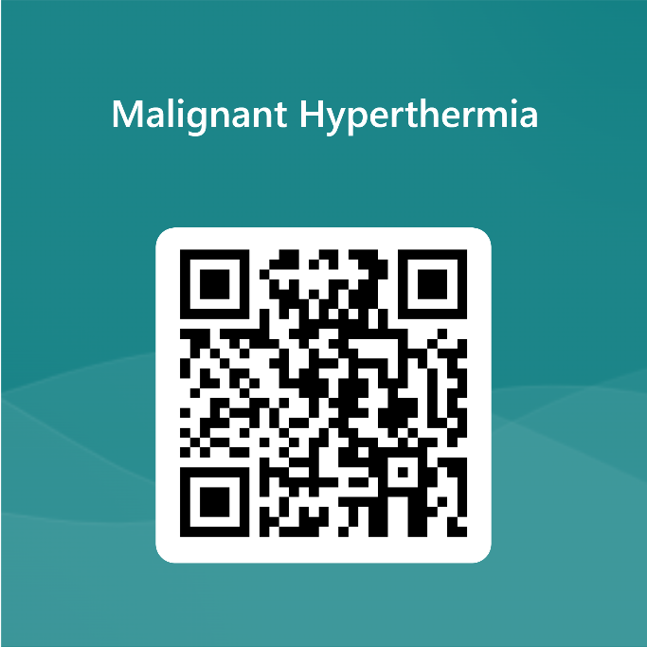
Please continue with the test for Malignant Hyperthermia
Link
QR Code
https://forms.office.com/r/uVCqbDpDta

